Slide 1
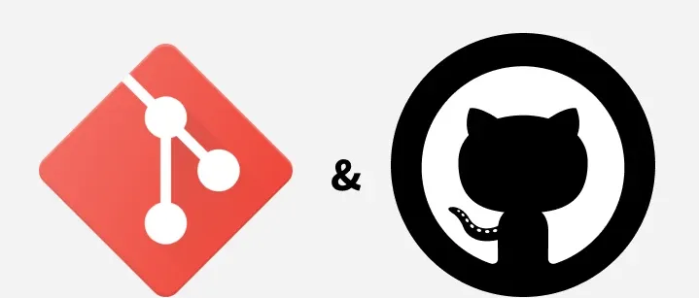
Git and GitHub
The Evolution of Collaborative Work
Shalini Amin
MAET PT 2025 - 27

Slide 2
What is Git?
A distributed version control system that tracks changes to files over time — letting multiple people work on the same project without overwriting each other's work.
CENTRALISED
GIT (DISTRIBUTED)
SERVER
One shared source of truth
Every peer holds a full copy

Slide 3
What is GitHub?
A cloud-based platform built around Git — a place to store and share repositories, layered with tools for collaboration.
push
LOCAL
GIT REPOSITORY
GITHUB
(CLOUD)
pull
Git is the version-control system. GitHub is a platform that supports collaboration and sharing using Git — related, but not the same.
Hosting + pull requests + review + issues + discussions

Slide 4
Why Did They Emerge?
2005
Today
Git is created
Industry standard
Linus Torvalds builds Git for Linux kernel development after a licensing dispute ends the community's use of BitKeeper.
Git + GitHub underpin open-source, enterprise, and research software development worldwide.
2008
GitHub launches
An online home for Git repositories — hosting, sharing, and a social layer for developers.

Slide 5
How Git Works
1
2
3
4
REPOSITORY
BRANCH
COMMIT
MERGE
Holds the project and all its files
Creates a separate line of work
Records a set of changes
Brings changes back to the main line
main
feature branch
Developers create branches, make and record changes, and merge completed work back into the main project.

Slide 6
How GitHub Works
1
2
3
4
REPOSITORY
BRANCH & COMMIT
PULL REQUEST
REVIEW & MERGE
Stores project and its files
Work on changes separately and record them
Propose changes for review
Review, approve and integrate changes
main
Feature branch
Developers work on branches, submit changes for review, and merge approved changes into the main project.

Slide 7
Who Uses Git & GitHub — and Where?
Software, web, product development
Data science & data engineering
AI & machine learning
Open-source development
Technical & research projects
Education and learning resources
From individual developers and startups to universities, governments, and large organisations, Git and GitHub are used across many sectors and locations.

Slide 8
How to Access Git and GitHub
Git
GitHub
Local & Independent
Web-Based & Collaborative
✓ Free and open-source
✓ Web-based platform
✓ Works on Windows, macOS, Linux
✓ Requires a free account
✓ Use independently without GitHub
upload
✓ Make repositories public or private
✓ Manage projects locally on your computer
✓ Share and collaborate in the cloud
✓ No account required
✓ Upload Git repositories for collaboration
Alternatives
GitLab and Bitbucket also provide Git-based repository hosting and collaboration features as alternatives to GitHub.

Slide 9
Why Git and GitHub Matter
Git lets developers experiment, test, and revert — turning software development into small, iterative steps instead of edits to one fixed version.
Experiment
GitHub extends this by letting the work be shared, reviewed, and developed by many contributors at once — crucial for large, continuously changing projects.
Test
Revert / Refine
In education, commits on GitHub can create a record of learning over time, thus helping learners reflect on their progress, maintain consistent effort, and track how their work develops.

Slide 10
McLuhan's Tetrad: Enhance & Obsolesce
ENHANCES
MAKES OBSOLETE
Iterative development — experiment, test, revert
A single, fixed version of a project
Transparency — every change is tracked over time
Manually tracking changes or saving copies
Collaboration — shared, structured, visible peer review (GitHUb)
Sending files back and forth to collaborate
Starting projects from scratch when existing work can be reused (GitHub)

Slide 11
McLuhan's Tetrad: Retrieve & Reverse
RETRIEVES
REVERSES INTO, AT EXTREMES
A record of how work develops over time
Too many branches — unclear what's current
Clear authorship — changes tied to the person who made them
Change-tracking that overwhelms large, active projects
Visible peer review and collective contribution
A steep learning curve for newcomers
A tool designed to make development more flexible can, at an extreme, make the process more complicated.
Notes:
Students need to add commit; post metacognition – what they did and why

Slide 12
THE BIGGER PICTURE
From static files to living projects
Git keeps track of how a project changes over time.
GitHub gives people a space to share work, review changes, and contribute.
Together, they support a shift from static files to projects continuously updated, shared, and built by many people at once.
For learners, Git and GitHub support iterative development, documentation, reflection through commits, peer review, and remote collaboration.

Slide 13
Videos to Learn More
Git and GitHub – https://www.youtube.com/watch?v=QzvA7r-WndM&vl=en&t=303
GitHub for Beginners: https://www.youtube.com/watch?v=a9u2yZvsqHA
Git and GitHub Tutorial for Beginners: https://www.youtube.com/watch?v=tRZGeaHPoaw

Slide 14
References
Git – About – Official overview of what Git is and how it works. https://git-scm.com/about
Git – Documentation / Book – Detailed explanation of repositories, commits, branches, merges, and distributed workflow. https://git-scm.com/doc
GitHub Docs – “What is GitHub?” – Explains GitHub as a platform built around Git, with repos, pull requests, issues, etc. https://docs.github.com/en/get-started/start-your-journey/what-is-github
GitHub Docs – “Using pull requests” – Your PR definition and workflow details. https://docs.github.com/articles/using-pull-requests
GeeksforGeeks – “History of Git” – Covers the 2005 Linux kernel context, BitKeeper licensing dispute, and why Git was created. https://www.geeksforgeeks.org/git/history-of-git/
LinkedIn article – “From Linus to GitHub: The Fun and Fascinating History of Git” (Michael Baker) – Narrative on BitKeeper crisis, Git’s design goals, and GitHub’s role in making Git social and accessible. https://www.linkedin.com/pulse/from-linus-github-fun-fascinating-history-git-michael-baker
WIPO blog – “Software Collaboration Hits 5 Billion GitHub Commits” (2026) – Evidence of wide adoption across industries and the scale of Git/GitHub use globally. https://www.wipo.int/en/web/global-innovation-index/w/blogs/2026/software-collaboration-hits-5-billion-github-commits

Slide 15
Thank You
Declaration of AI Use: Google AI Mode and Perplexity were used for research, Claude for slide-deck development, and ChatGPT for brainstorming and language refinement; all thoughts, interpretations, final analysis, and decisions are those of the author.

